Slide 1
Credit Card Purchase Trend Analysis
Mayank Porwal

Slide 2
Agenda
Introduction
Primary goals
Insights/Trend analysis
Dashboard
Summary

Slide 3
Introduction
In this presentation we will analyze about what are the trends of the purchases made using credit card over a period (Oct-2013 to May-2015)
With data such that Customer’s gender, date of spending, city, card type used, expense type, amount of spending for usage.

Slide 4
Primary goals
Trend of Spendings using Data

Slide 5
Monthly performance
Big Dip has been observed in spending from April-2015 to May-2015 from 208M to 173M which is lowest.
That is around -17% when compared Month-on-Month Basis.

Slide 6
Expense Type - Spending
As see from pie chart below travel is less popular expense type where majorly Bills are paid using credit card while other categories have similar contributions

Slide 7
Gender Wise spending Habits
Female spend more as compared to Male using Credit card as seen in Pie Chart
Also when checked Avg. order amount for females is also more than male customers
Trend of Male spending more on Fuel exp type where as Female Spend more on Bills exp type is observed.

Slide 8
Spending of Customers in Different Cities
Here is the graph showing top 12 cities in terms of total spendings.
80% amount of the spending done using credit card users are from these 12 cities out of 987 cities in which customers using credit card are present
These are basically India’s big metropolitan cities that contributes to maximum spending done using credit card.

Slide 9
Card Type - Spending
Silver Card type is most popular among customers also spending by this type of card is maximum after Signature and Platinum.
Also Gold Card Type is least popular among all card types.

Slide 10
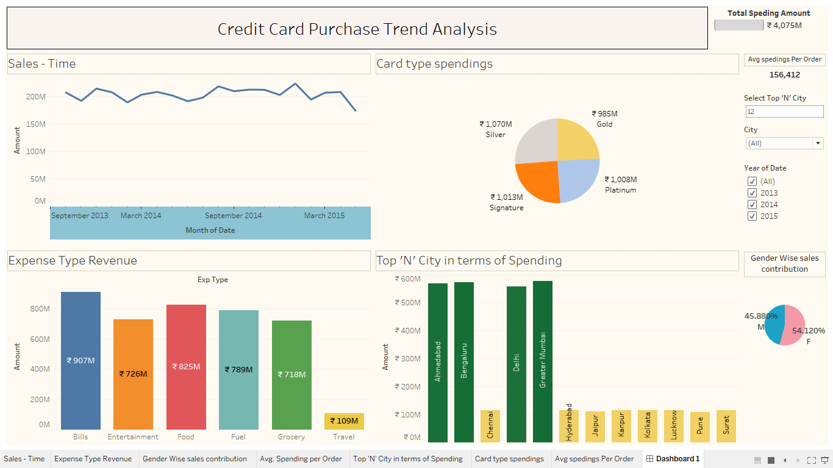
Snap-Shot of DashBoard

Slide 11
Summary
We clearly see fall in spending using credit in last couple of months.
Also Female contribute more to total spending using Credit Card so they can be good customer segment to be targeted
Sales across different cities is not distributed, 80% spendings are done by customers living in Top 12 cities of India.

Slide 12
Thank you
Mayank Porwal​
https://www.linkedin.com/in/mayank-porwal-india

